Slide 1
Practical Data Science
Python, R, and D3.js

Slide 2

SPEAKER
Ahmed Sherif
Business Intelligence since 2005
Transitioned into Data Science in 2013
Northwestern University Predictive Analytics (2014-2016)
Consultant with Convergence Consulting Group since 2016

Slide 3
Agenda
What is Practical Data Science
The Transition away from SAS
Explore D3, R, and Python
Demo – twitter

Slide 4
What is Practical Data Science
Introduction

Slide 5
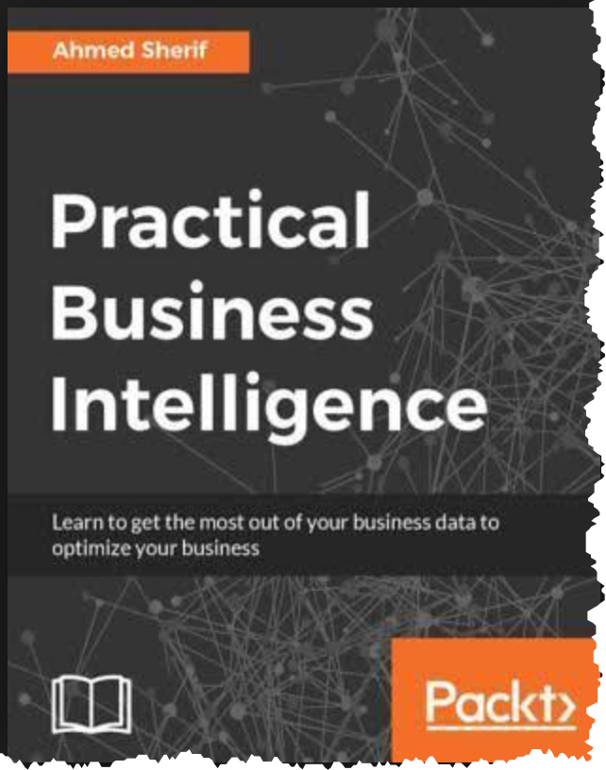
Practical Data Science
In 2016, I was asked to write a book on Business Intelligence using the following:
Power BI
Tableau
QlikSense
R
Python
D3.js
I understood the reasoning behind the first 3 tools
I was struggling to understand where they were coming from in regards to R, Python, and D3

Slide 6

Practical Data Science
I then had a eureka moment
Back in school we used the following:
Rstudio
IPython Notebooks (Jupyter Notebooks)
HTML
All use markup
All deliver data as information to users
All made available with the introduction of IDE’s
Integrated
Development
Environment

Slide 7
Open Source Data Science
SAS vs Open Source

Slide 8
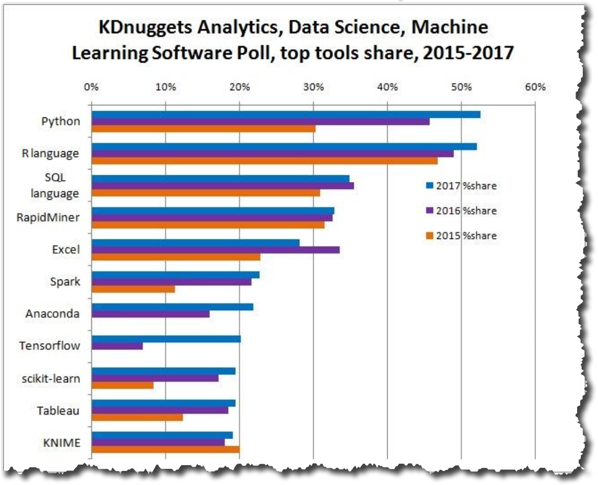
Why the transition from SAS/SPSS to R/Python
SAS used to be the only name in the game for Data Science for many years
That is not necessarily the case anymore
R and Python are catching up
Some might even say that they’ve caught up and exceeded SAS

Slide 9
What are the reasons for the transition
Cost & Availability
Transition from Academia to Industry
Customization (Getting underneath the hood)
Ecosystem and Community
Enhancements
Data Visualization tools such as Tableau

Slide 10
The competitors to SAS are catching up
Microsoft has Azure Machine Learning (uses Python & R)
IBM has Watson Data Platform (Data Science Experience with Python)
Dataiku – Data Science Studio (Python & R)
Alteryx uses Python or R

Slide 11
Explore D3, R, and Python
Introduction

Slide 12
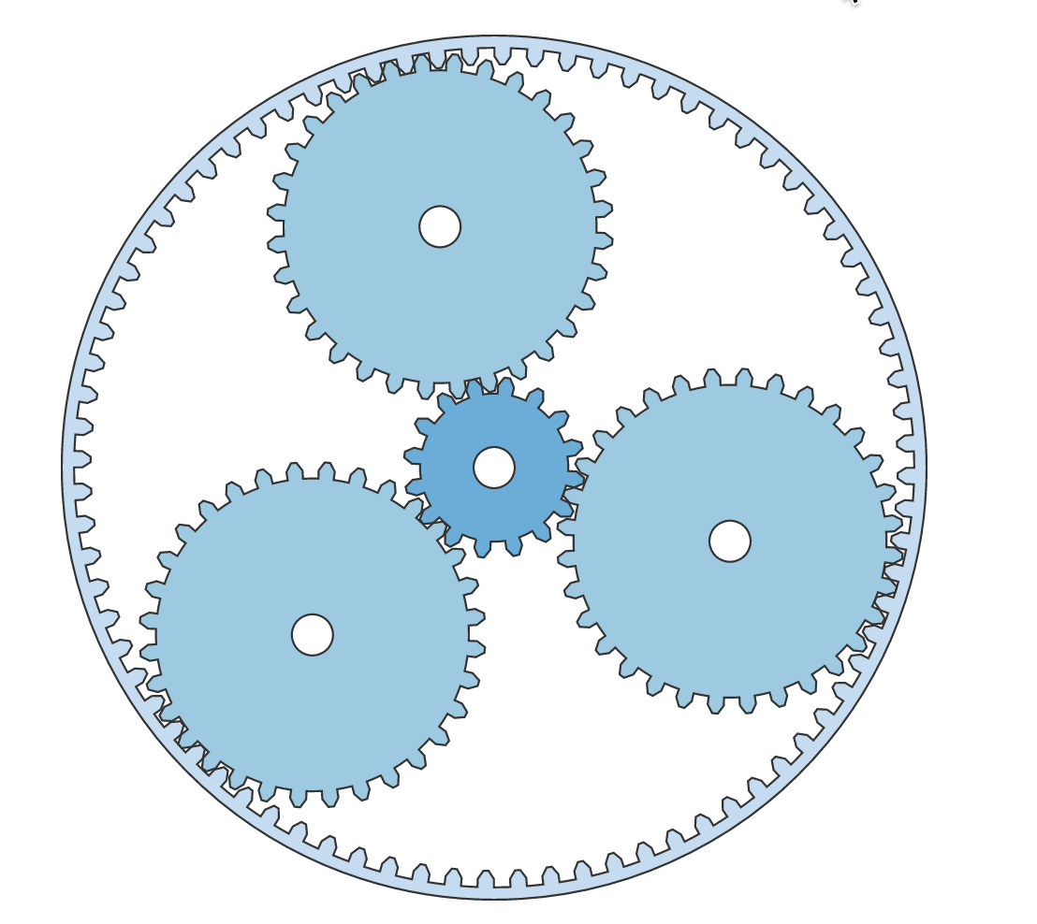
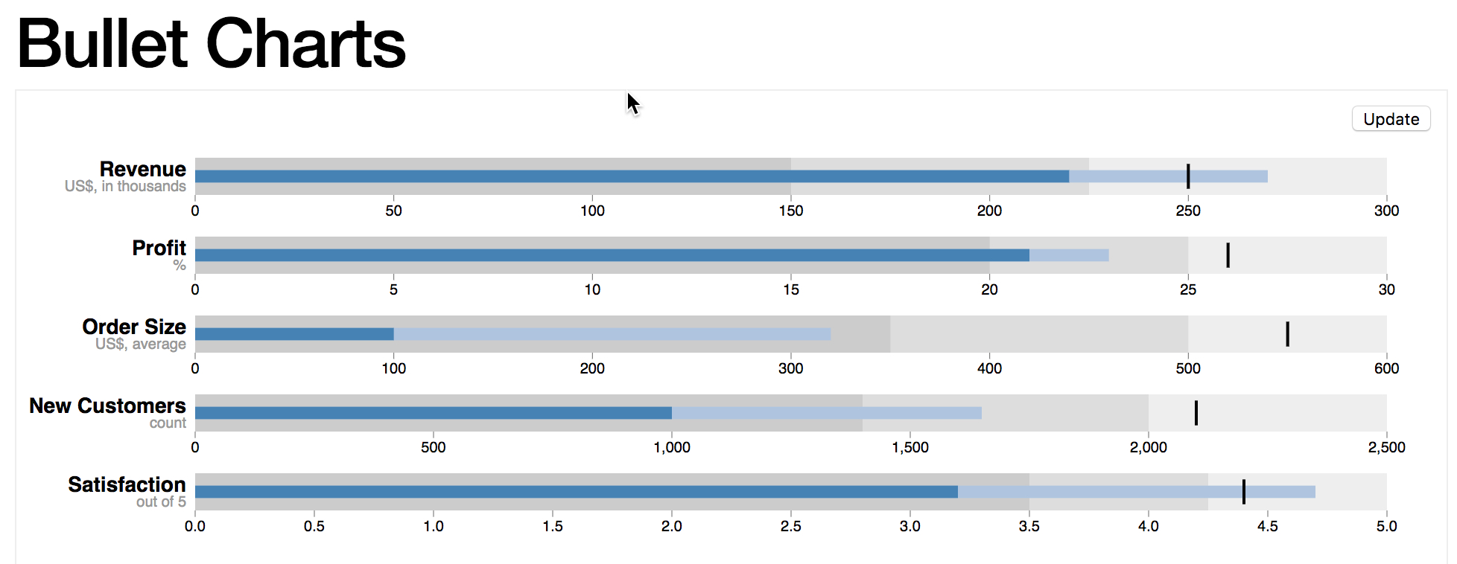
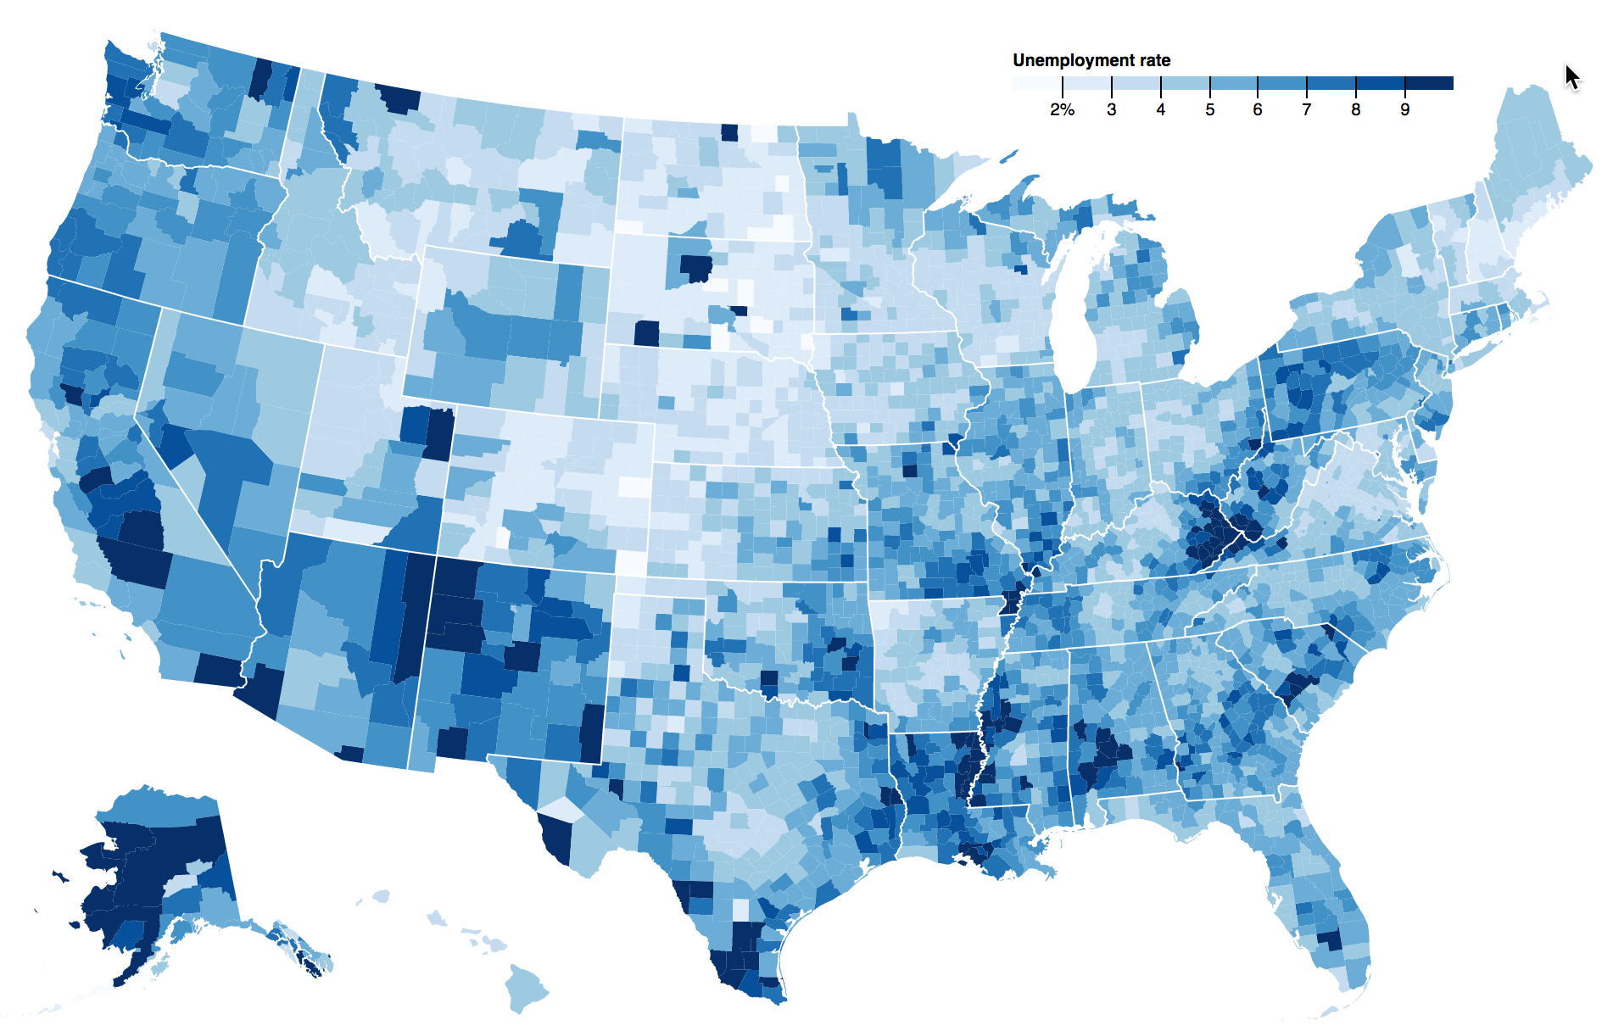
D3 Visualizations
You can make some pretty cool visualizations in D3

Slide 13
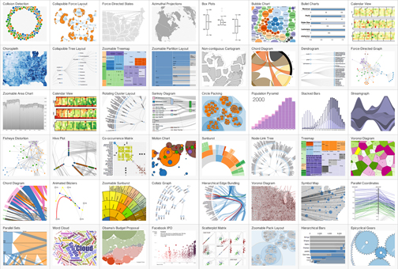
D3 Visualizations
D3 stands for Data Driven Documents
It leverages everything that makes up the web
Which makes sense since it is a JavaScript library
Developed by Mike Bostock in 2011 while he was working at the NY Times to leverage advanced visualizations that he found were not available with the current tools on the market

Slide 14
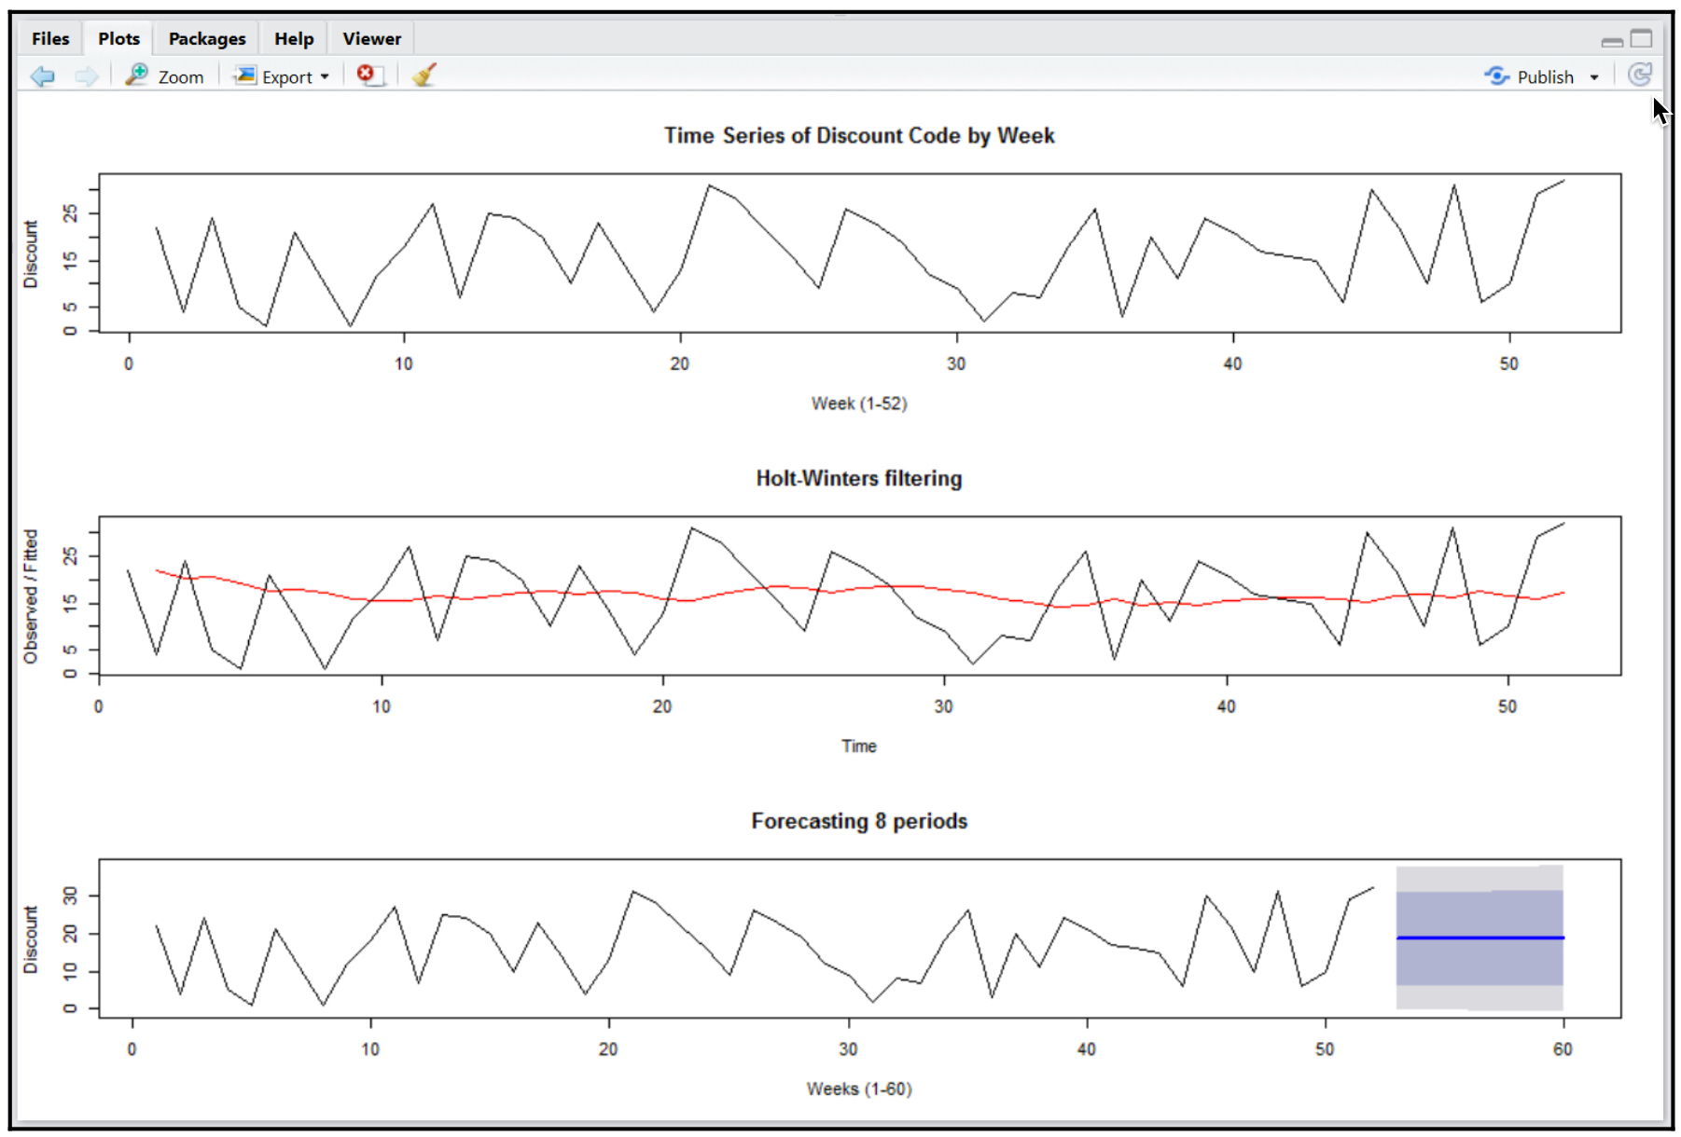
R
Does not require an introduction for use in Data Science
The statistical programming open source language
Much of my interest with R dealt with
Time Series
Forecasting

Slide 15
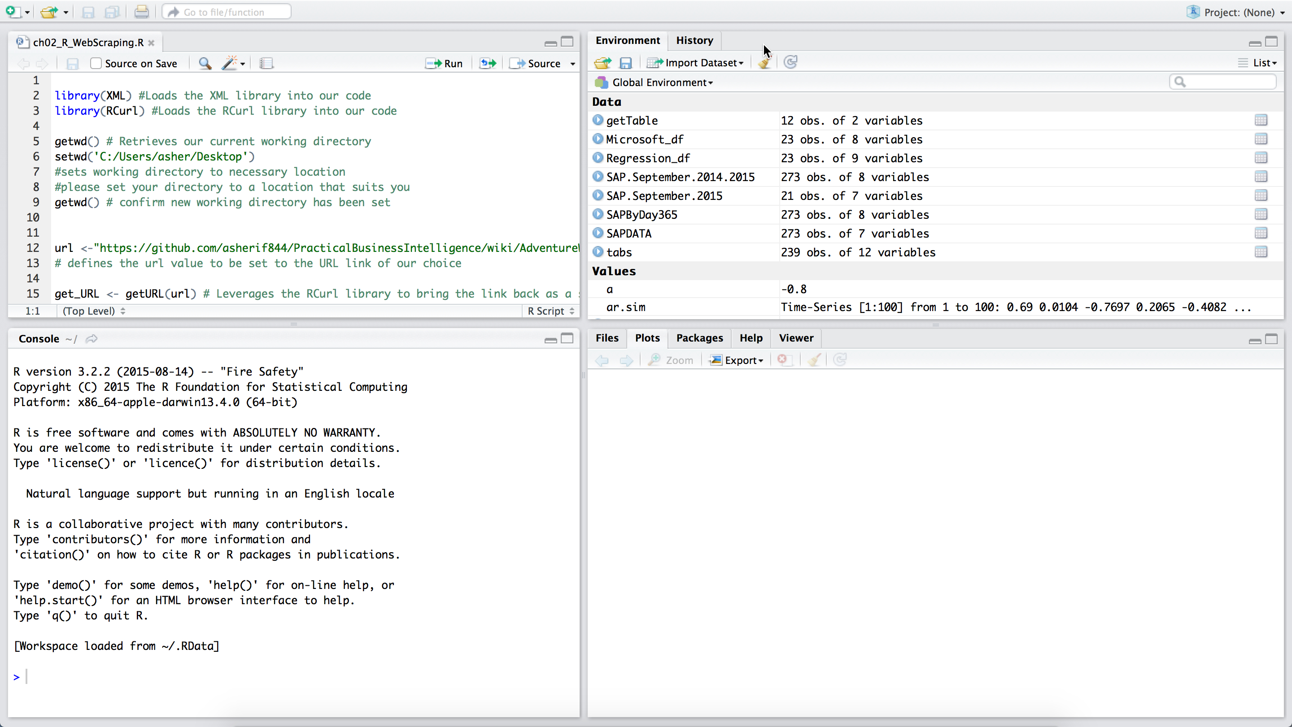
RStudio Enhances R
R is a bit ’raw’ in its original form
RStudio is an IDE that provides a user-friendly environment to work within

Slide 16
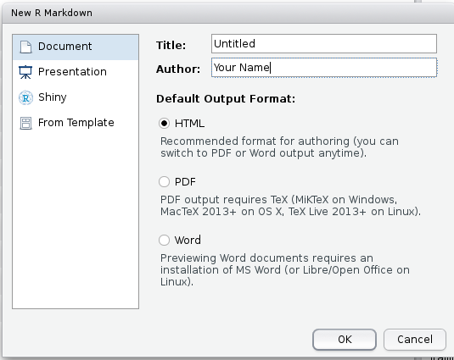
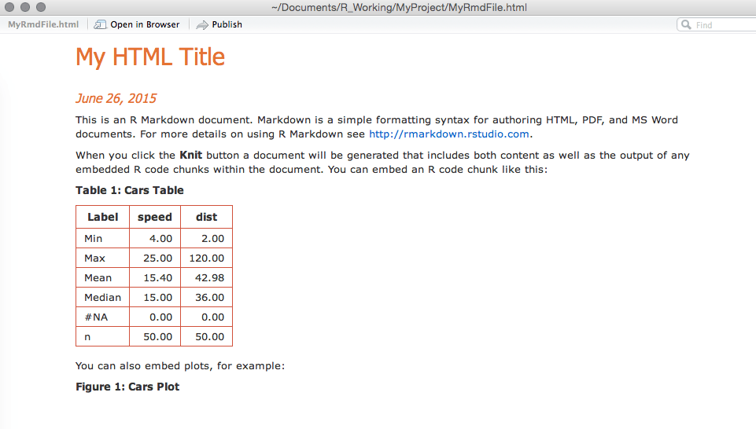
Rstudio Knit to HTML

Slide 17

Python
Python is the jack of all trades
But the master of none

Slide 18
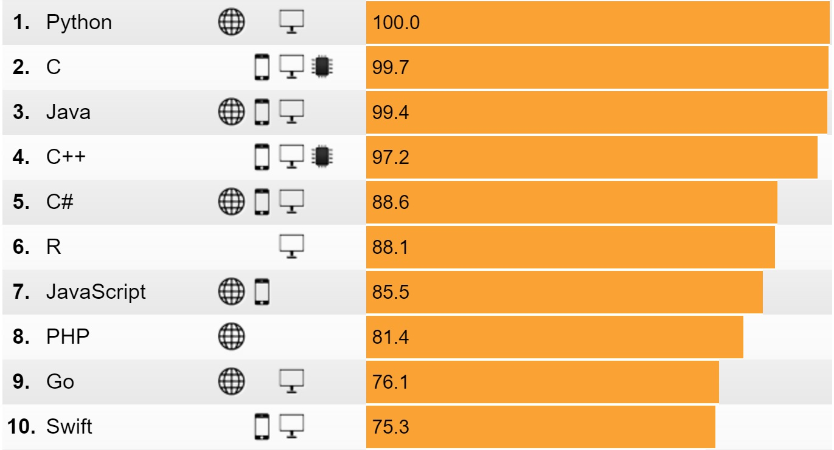
Python
It’s being learned by non-developers
Introductory programming language in colleges
It’s known as an easy programming language to ’pick up’
Aside from data science, it is known for:
Game Development
App Development
Web Development

Slide 19
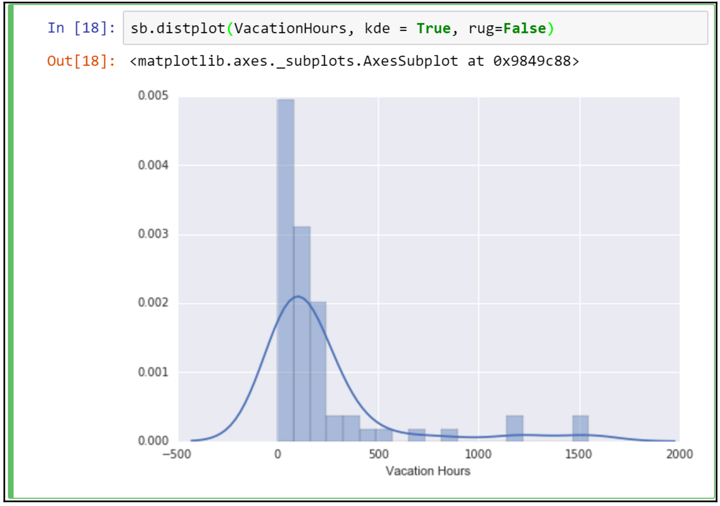
Python
Python has great libraries for statistical analysis and modeling
Numpy
Pandas
Scikit-Learn
Python has an equal number of growing visualization libraries
Matplotlib
Seaborn
Bokeh
Plotly
Pygal
ggplot

Slide 20
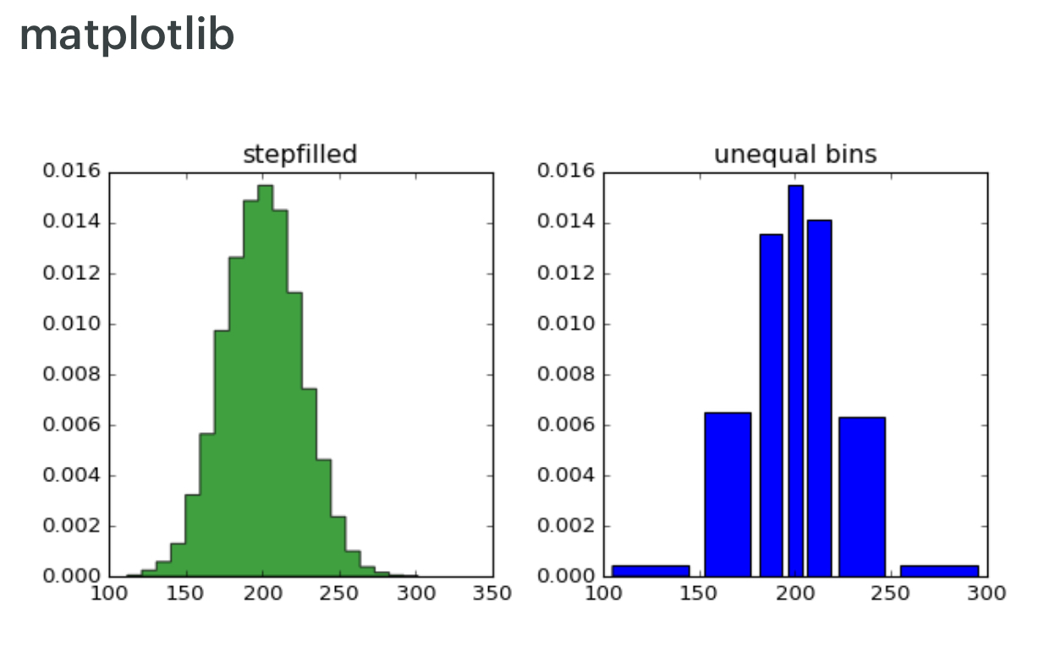
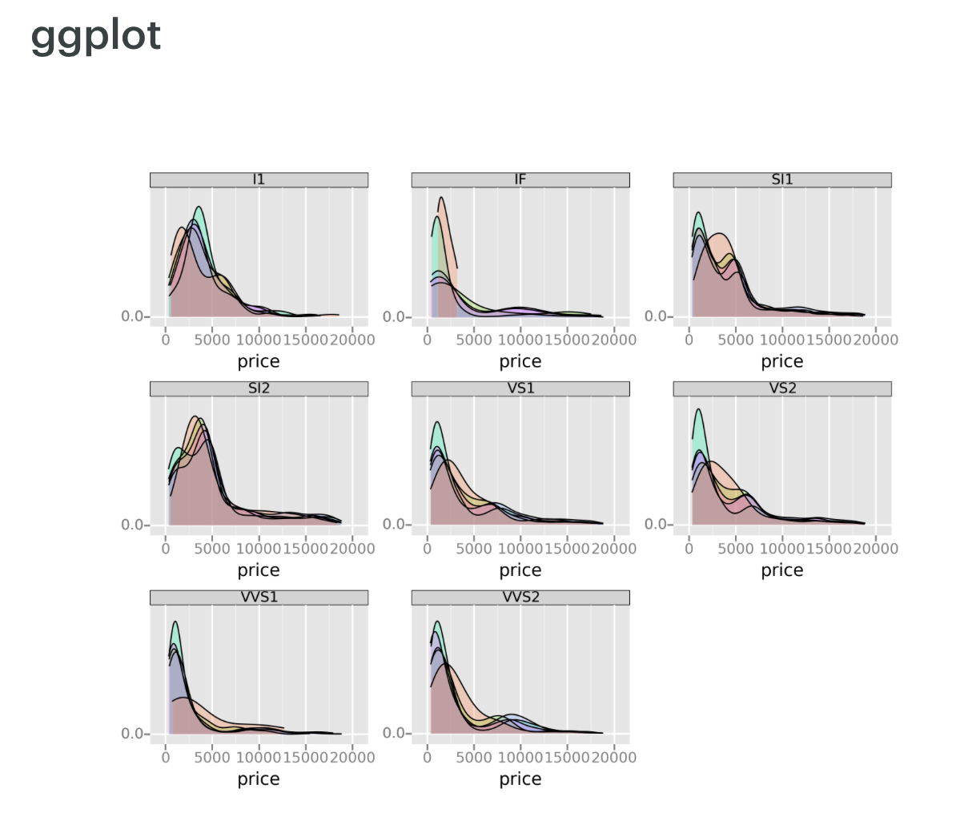
Python Visualizations

Slide 21
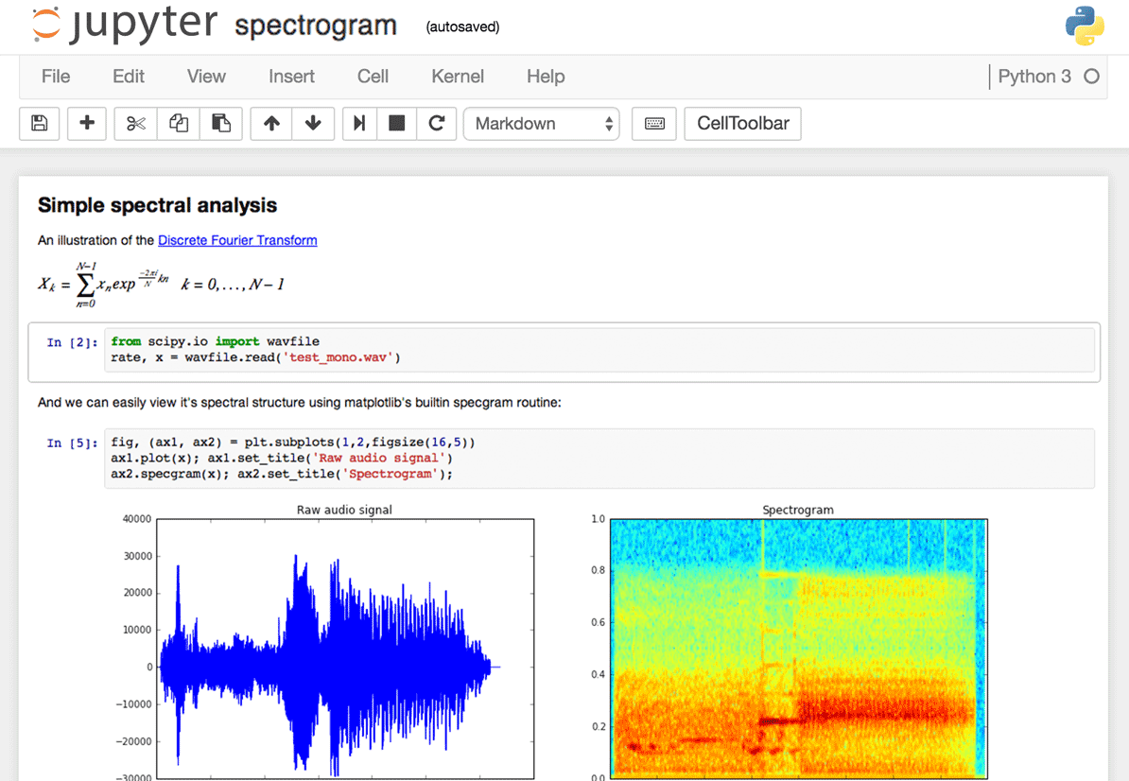
Jupyter Notebooks
A re-imagining of the IPYTHON notebook
Does anyone know how the word Jupyter came about?
Julia
Python
R
Think of it as an online IDE
Developers can create and share documents that contain live code, equations, visualizations as well as text
Speaking of Jupyter…

Slide 22
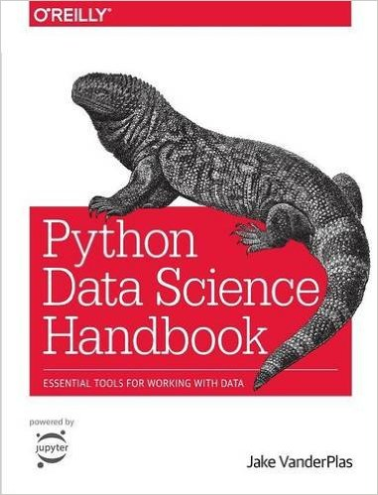
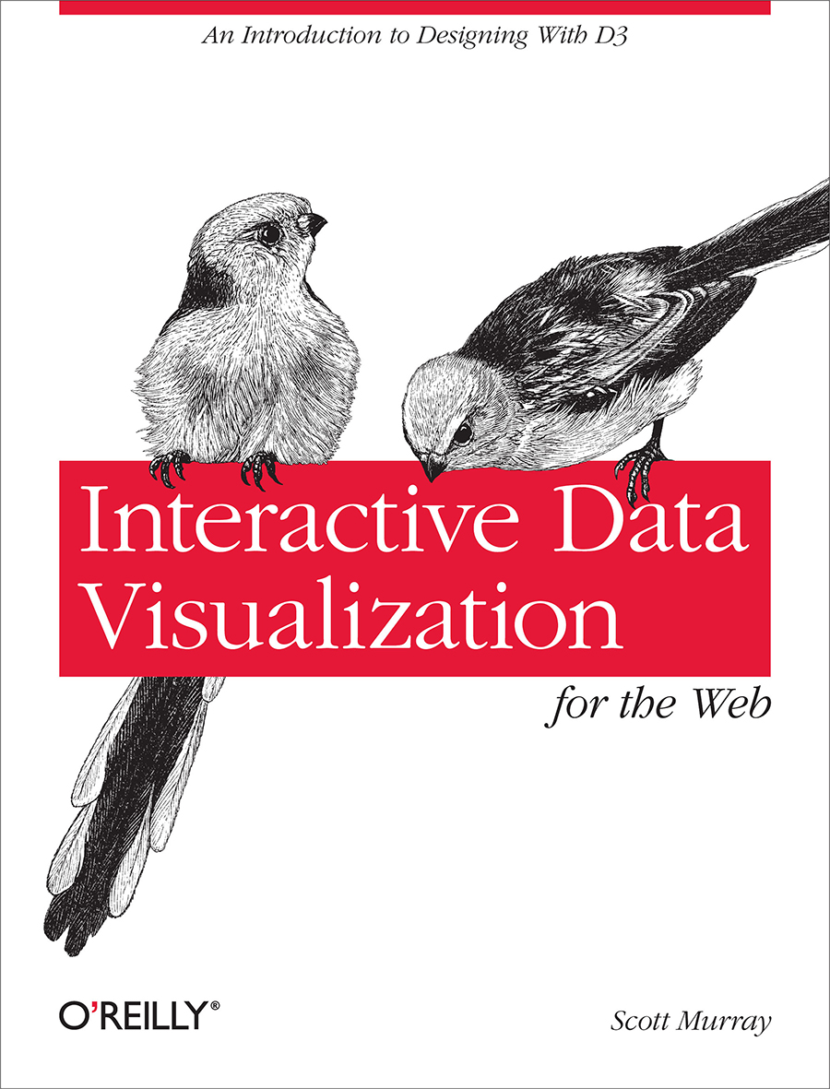
Recommendations

Slide 23
Demo
Stream twitter data with Python and visualize simultaneously with D3

Slide 24
Demo
Extract twitter data live using python
Visualize data live in D3.js
Further analyze data in R

Slide 25
THANK YOU!
Follow me @TheAhmedSherif

